Slide 1
Bioinformatics （生物信息学） BME1063.01 Lecture1. Class3
张力烨
ShanghaiTech University
School of Life Science and Technology

Slide 2
week1.class3
1. What is the definition of Bioinformatics
2. Why Bioinformatics is important
3. What is a good or bad bioinformatician?
4. Some general principles
5. Where to find help to solve problems

Slide 3
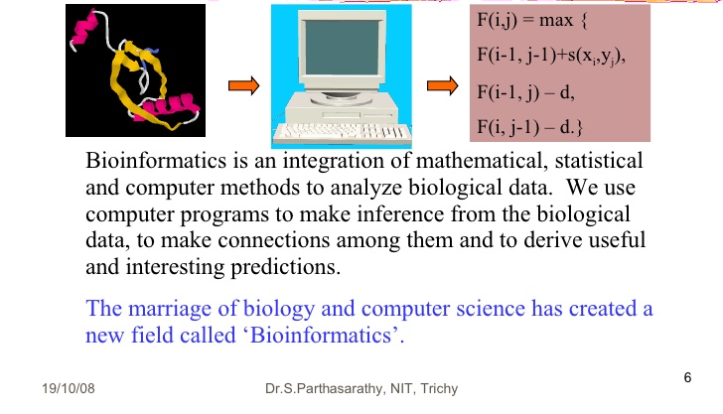
What is the definition of bioinformatics

Slide 4
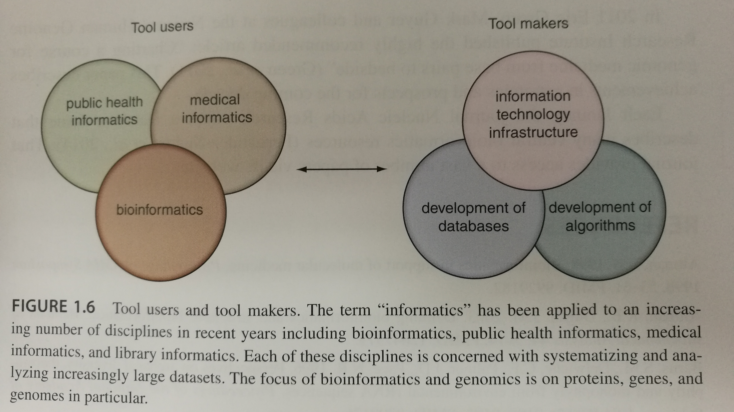
生物信息学的两大门派
Bioinformatics And functional Genomics, 3rd, Page 15

Slide 5
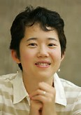
Further reading
http://www.longwoodgenomics.org/2014/10/11/levels-of-bioinformatics-research/

Slide 6
week1.class3
1. What is the definition of Bioinformatics
2. Why is Bioinformatics important
3. What is a good or bad bioinformatician?
4. Some general principles
5. Where to learn how to solve millions problem you will encounter when doing Bioinformatics?

Slide 7
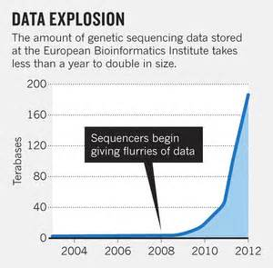
Why is Bioinformatics important?
In many cases, generating mass amount of data is easy, making sense of the data is much more difficult.
Vivien Marx. Nature 498,255-260,2013

Slide 8
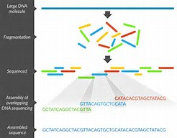
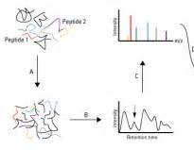
Why Bioinformatics is important
Technology enable new angel or high resolution in generating data, which keeps bring more and more complicated computational problem in biology, and also new opportunities and challenges to look into old data.
O(complexity of analysis)=2^{N}
DNA/RNA-Seq
Proteomics

Slide 9
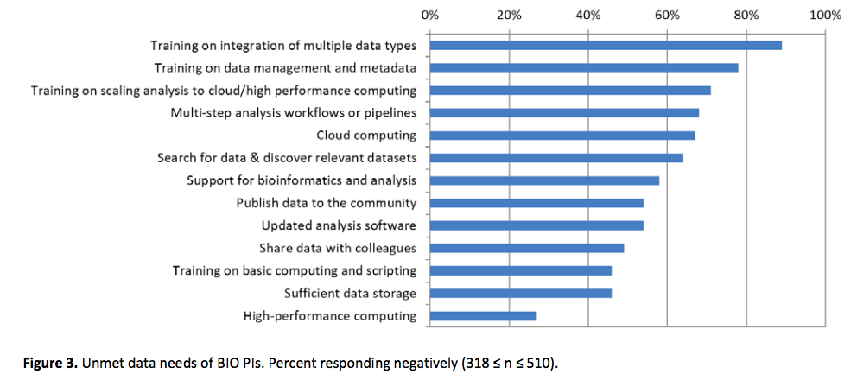
Unmet needs for Bioinformatics
http://www.biorxiv.org/content/early/2017/02/15/108555

Slide 10
week1.class3
1. What is the definition of Bioinformatics
2. Why Bioinformatics is important
3. What is a good or bad bioinformatician?
4. Some general principles

Slide 11


What is a good or bad bioinformatician
Present interpretable results
Output of a tool X
Know the best tool to use based on
The data/problem
Use the tools I know how to run
Generate testable/actionable assumption for bench collaborators
Here is what you asked “output
Of a tool X”
Come up with novel ways of analyzing the data and solving the problem
Do what they tell me to do

Slide 12
week1.class3
1. What is the definition of Bioinformatics
2. Why Bioinformatics is important
3. What is a good or bad bioinformatician?
4. Some general principles

Slide 13
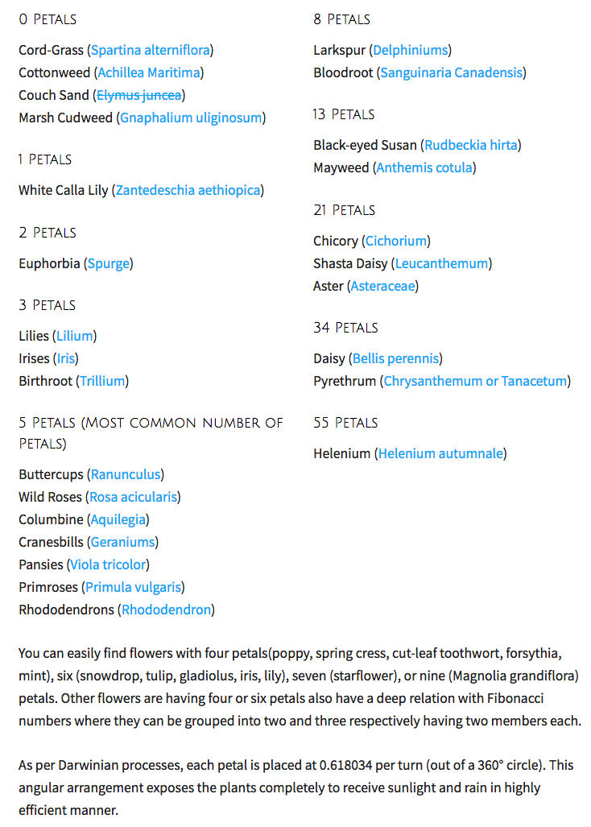



Principle Zero: number may mean something, think why you got that number

Slide 14
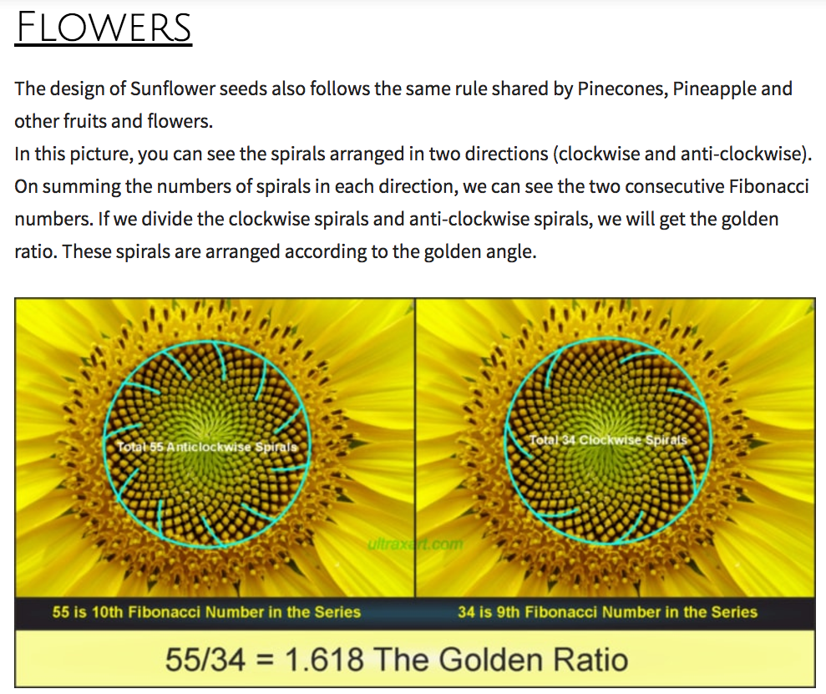

Slide 15
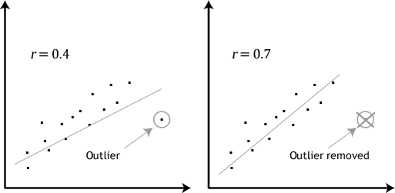
Principle I: do not fully trust the number, plot it

Slide 16
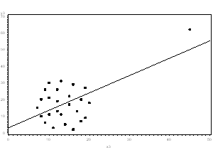
Principle I: do not fully trust the number, plot it

Slide 17
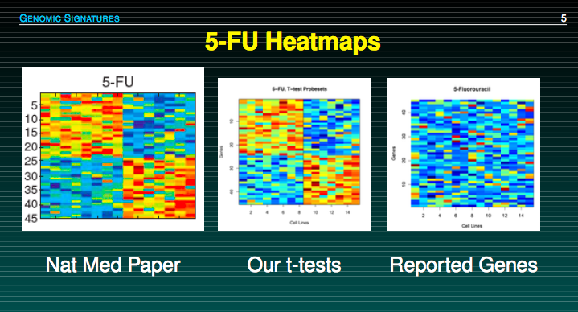
Principle II: mistake happened, double check your results in each step

Slide 18
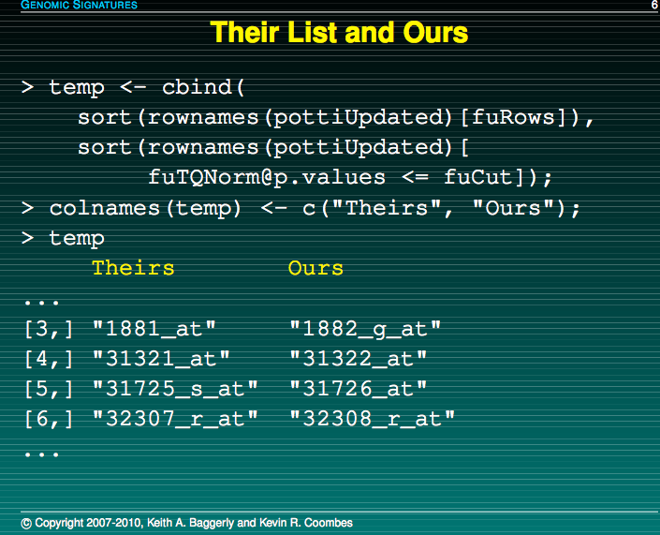
Principle II: mistake happened, double check your results in each step

Slide 19
Principle II: mistake happened, double check your results in each step
http://videolectures.net/cancerbioinformatics2010_baggerly_irrh/

Slide 20

Alternative Career Path：脱口秀

Slide 21
Principle III: when you do not know how to solve/understand the problem globally, go to raw data and start from individual examples

Slide 22
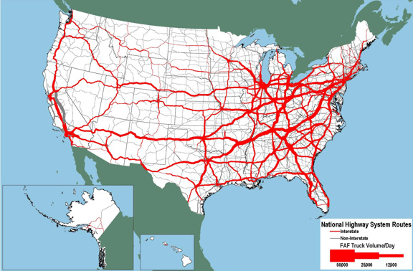
Principle IV: understand the Key tools and input/output
City:
Common file format
Such as fastq,BAM,BED,VCF
Highway:
Common Tools:
BWA, samtools,bedtools….

Slide 23
week1.class3
1. What is the definition of Bioinformatics
2. Why Bioinformatics is important
3. What is a good or bad bioinformatician?
4. Some general principles
5. Where to find help to solve problems

Slide 24
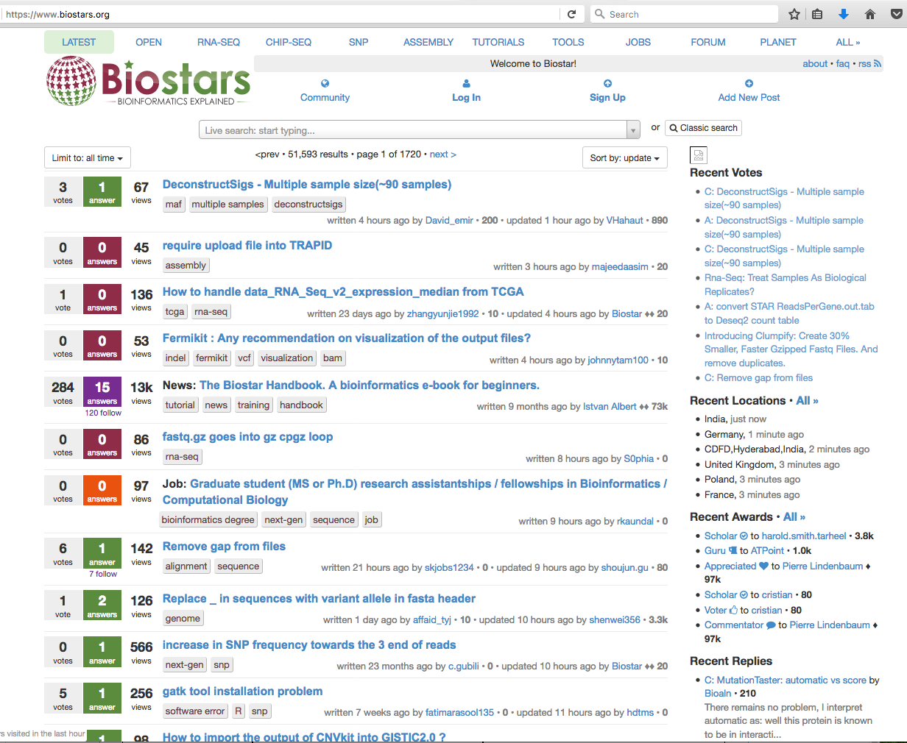


No.1 Go to places: biostars.org

Slide 25
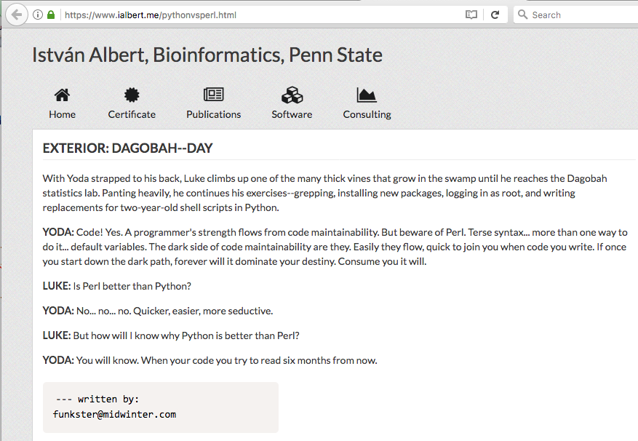
Side notes: use Python not perl

Slide 26
Side notes: recommended programming languages
Python (suggested reading: Dive into Python)
R
Advanced Level: Java ; C++

Slide 27
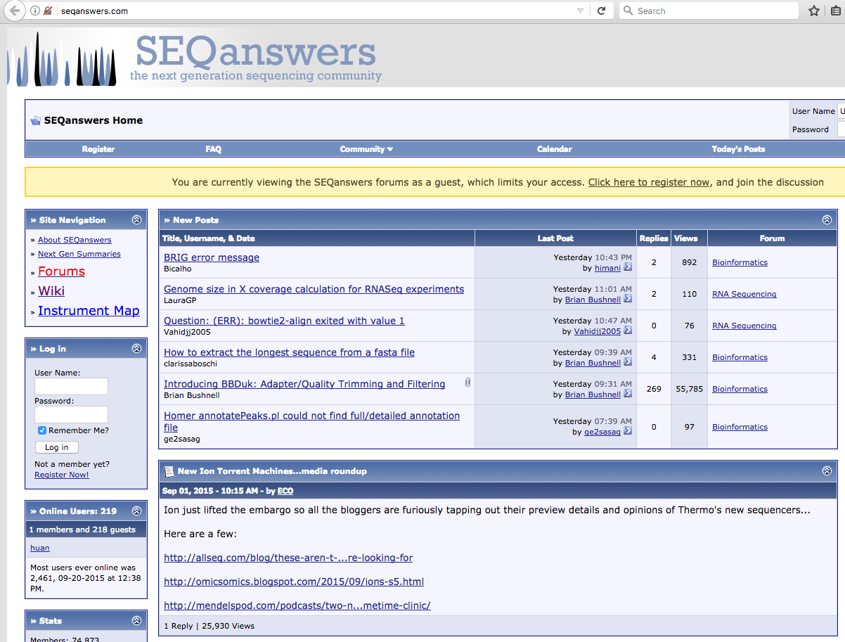
No.2 Go to places: seqanswers.com

Slide 28
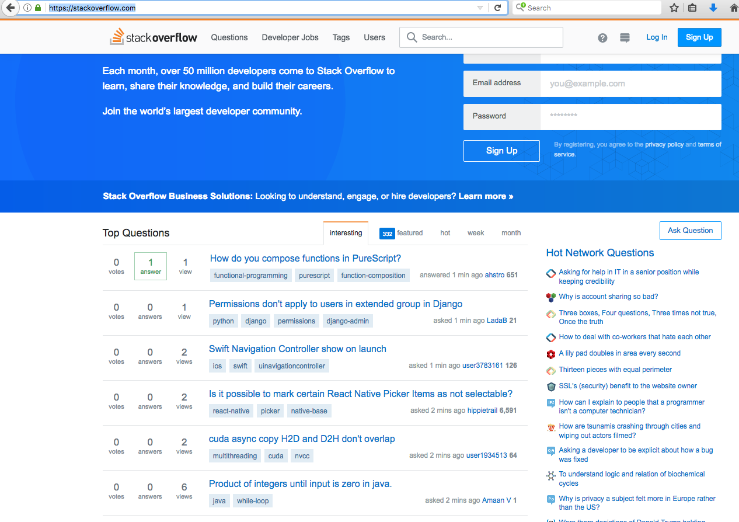
No.3 Go to places (more coding/computer then Bioinformatics): stackoverflow.com

Slide 29
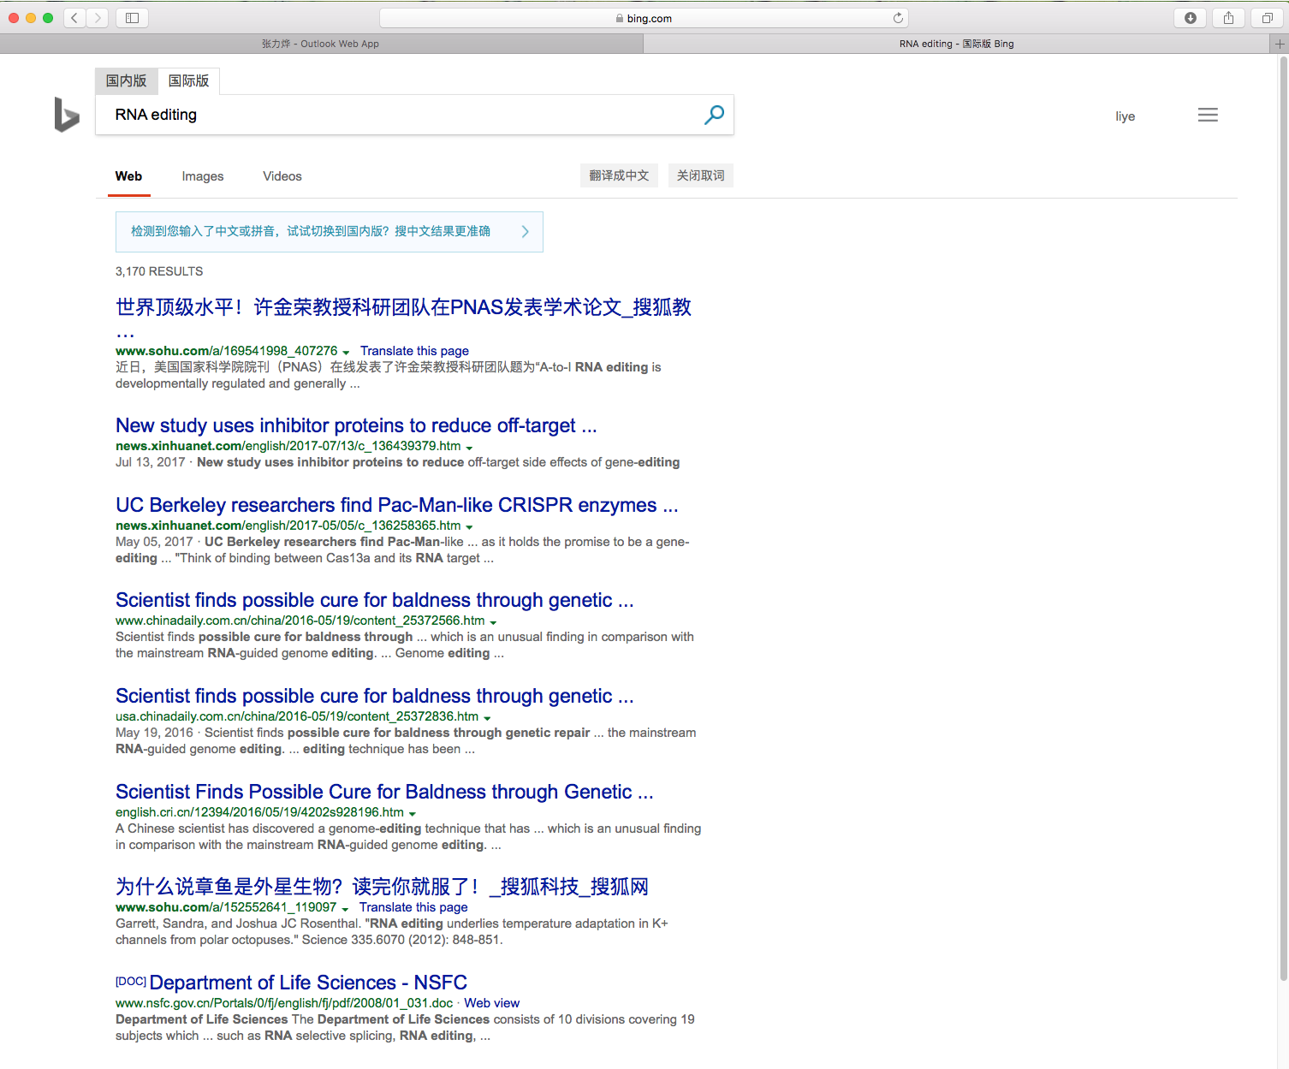
No.4 use bing and google (and do your search in English)

Slide 30
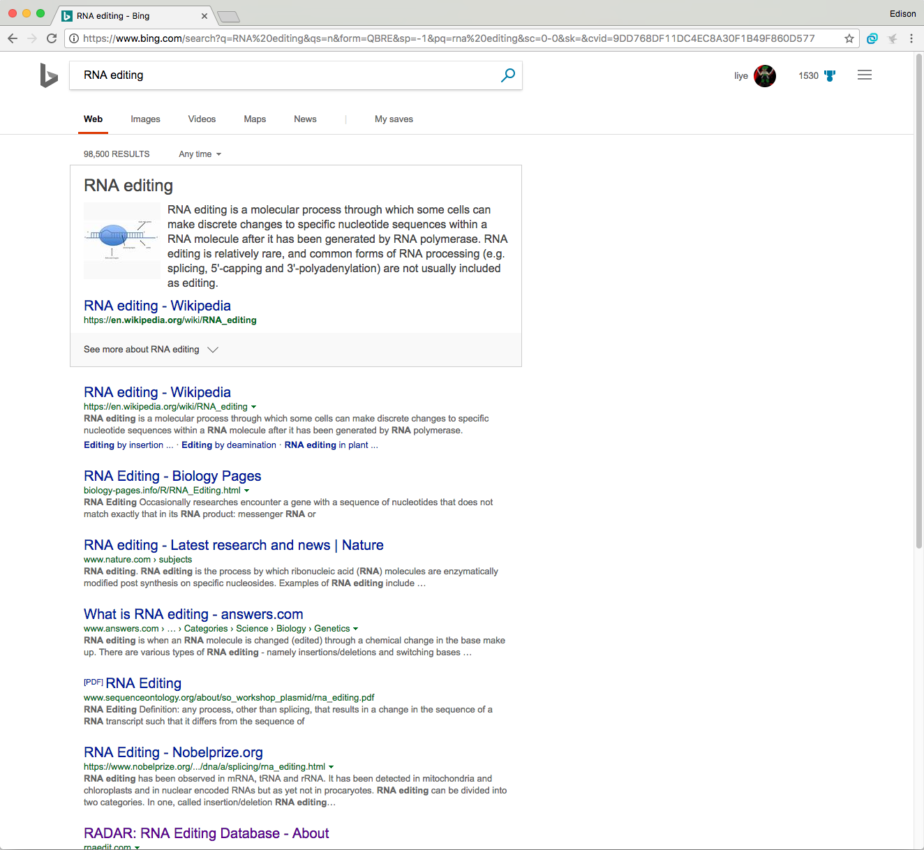
No.4 use bing and google (and do your search in English)

Slide 31
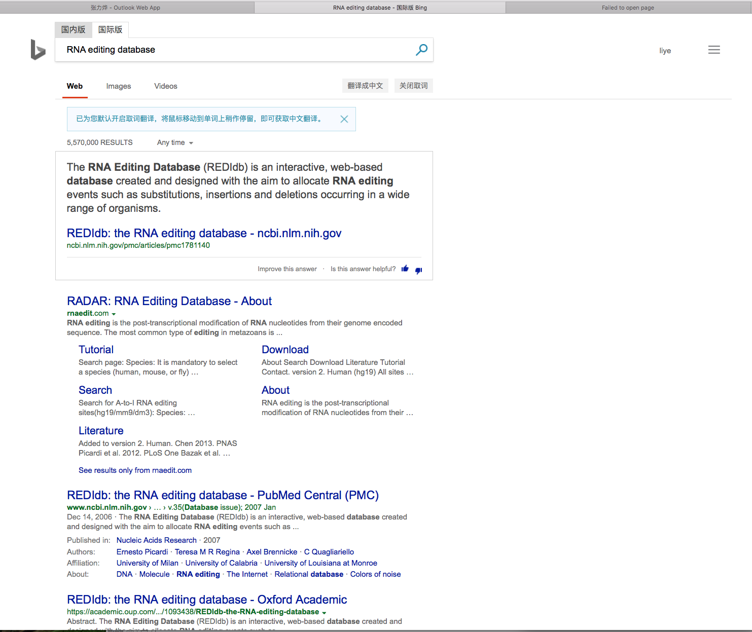
No.4 use bing and google (and do your search in English)

Slide 32
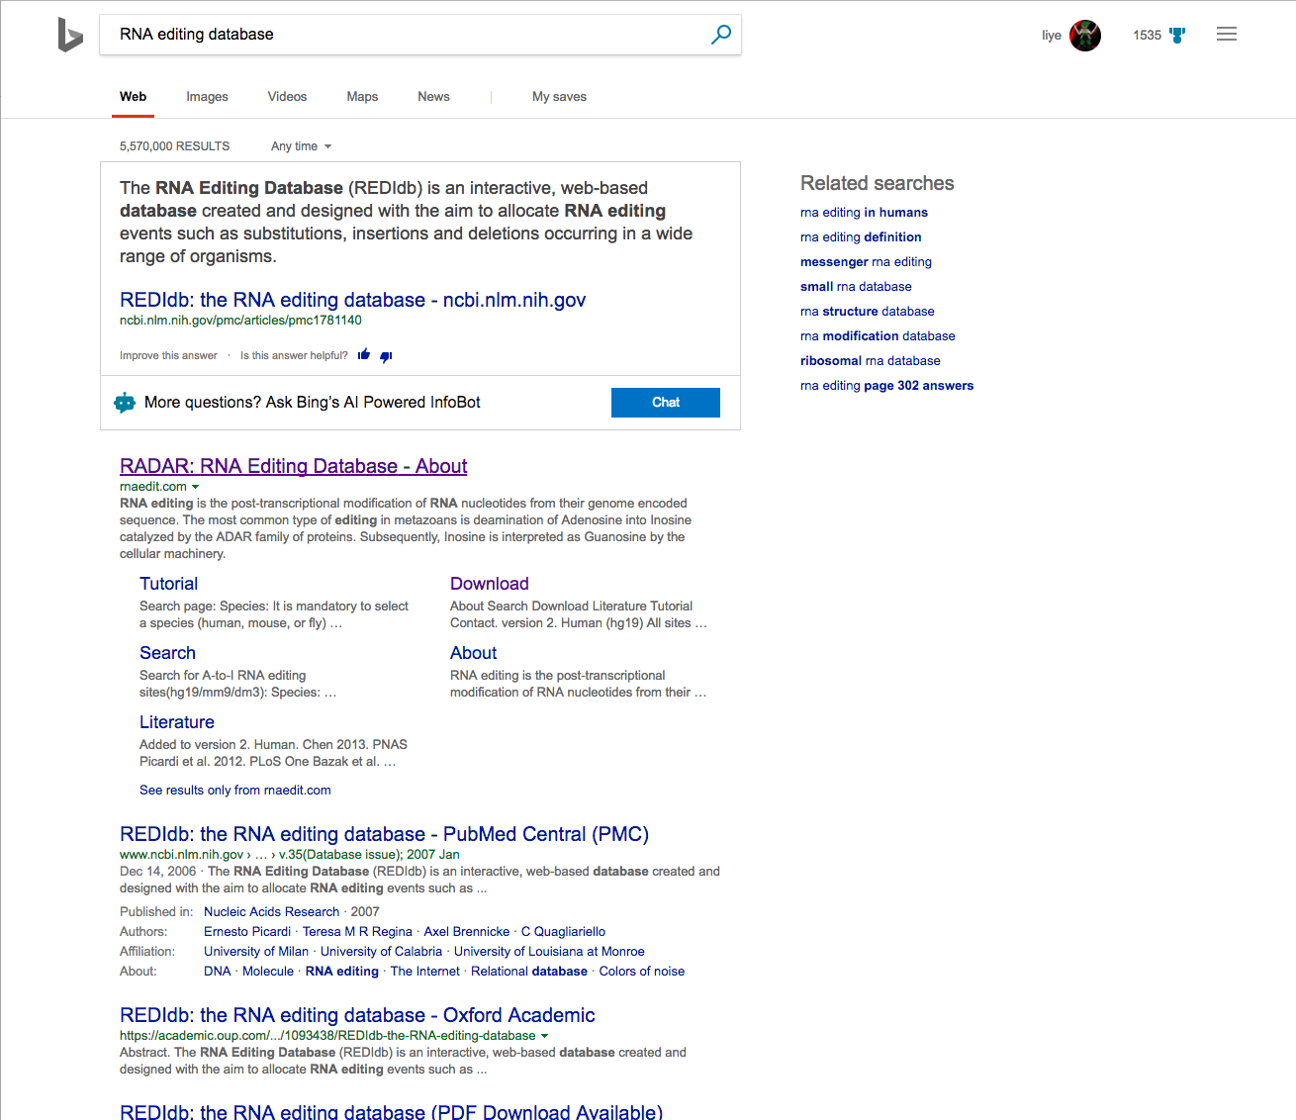
No.4 use bing and google (and do your search in English)

Slide 33
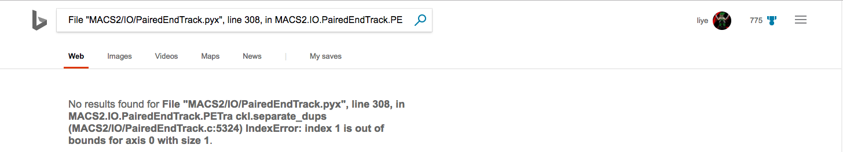
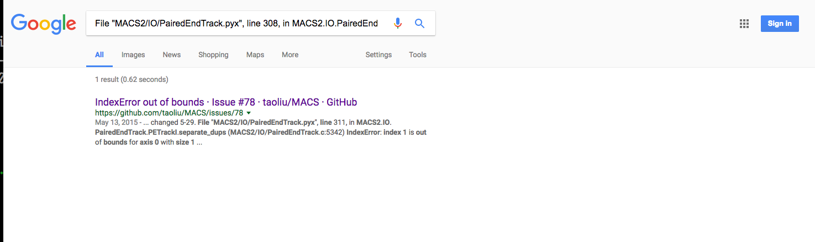
No.4 use bing and google (and do your search in English)

Slide 34
No.5 团结就是力量 (I suggest you form a wechat group and help each other)

Slide 35
Learn more about Bioinfo resources
https://www.coursera.org
https://ocw.mit.edu/index.htm
https://www.edx.org/
Youtube.com

Slide 36
Take Home messages for Week1
1. What is the scoring system and overall organization of the class
2. You should be able complete simple tasks/operations on the computer clusters
3. You should know some basic principles that I think it is important
4. You should know where to find resources to help you solve the problem

Slide 37
Optional reading
MIT class Introduction
Video at /public/home/zhangly/class/after-class-learn/class1

Slide 38
Prepare for next class
MIT class about BLAST and Short Read Alignment
Two Videos at /public/home/zhangly/class/class-prepare/class2
And one original reference for BLAST paper
Total time estimated to finish the preparation: >=3 hours

